Slide 1
Predicting
NFL Playoff Success
Phil Cork and Allison Hansen

Slide 2
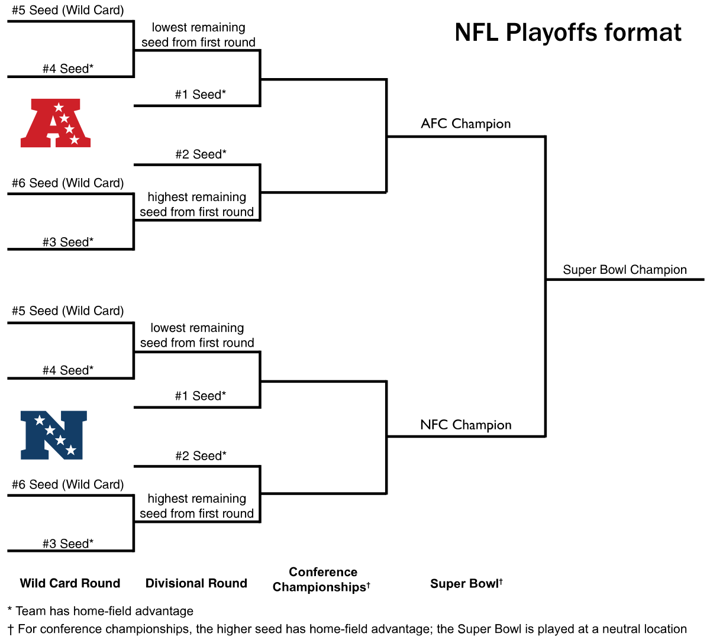
Evolution of Our Project
Began by wanting to predict Super Bowl outcomes, but it quickly became infeasible due to the limited number of instances for training and testing
We then looked to predict the win/loss outcomes of games based on season data and betting odds, but because of teams of the same year appearing in multiple playoff contests, faced an unavoidable data leakage, resulting in overfit training data
Finally, shifted to predicting whether teams reached certain contests within the NFL playoff landscape. This removed the duplicate instance issue and provided enough instances for realistic modeling to be attempted.

Slide 3
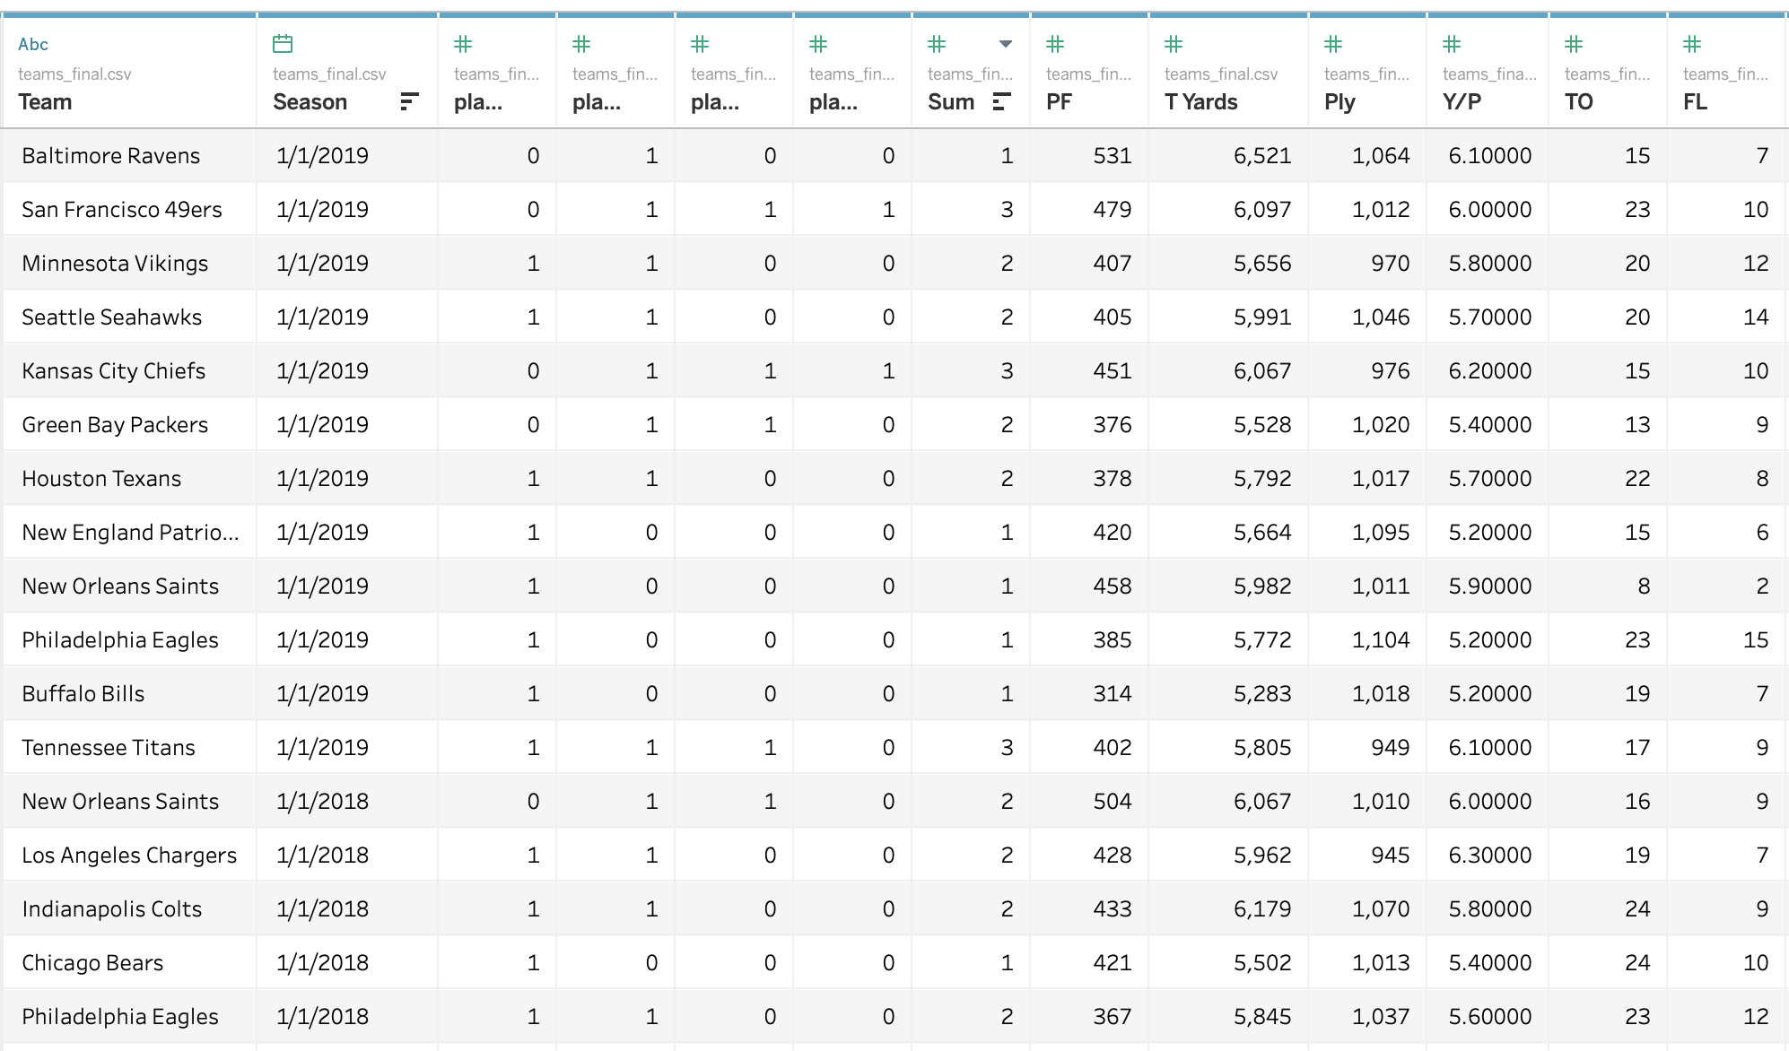
Dataset Introduction
Dataset includes playoff game results and participants for each NFL season dating back to 1988, with the expansion to 16-game seasons.
Merged this dataset with offensive and defensive seasonal statistics for each team for each given season, such as total yards, touchdowns, penalties, and turnovers for the team and opponents.
Transformed this dataset into one with an individual row for each team in each season and a binary output of whether they competed in and/or whether they won each round of the NFL playoffs.

Slide 4
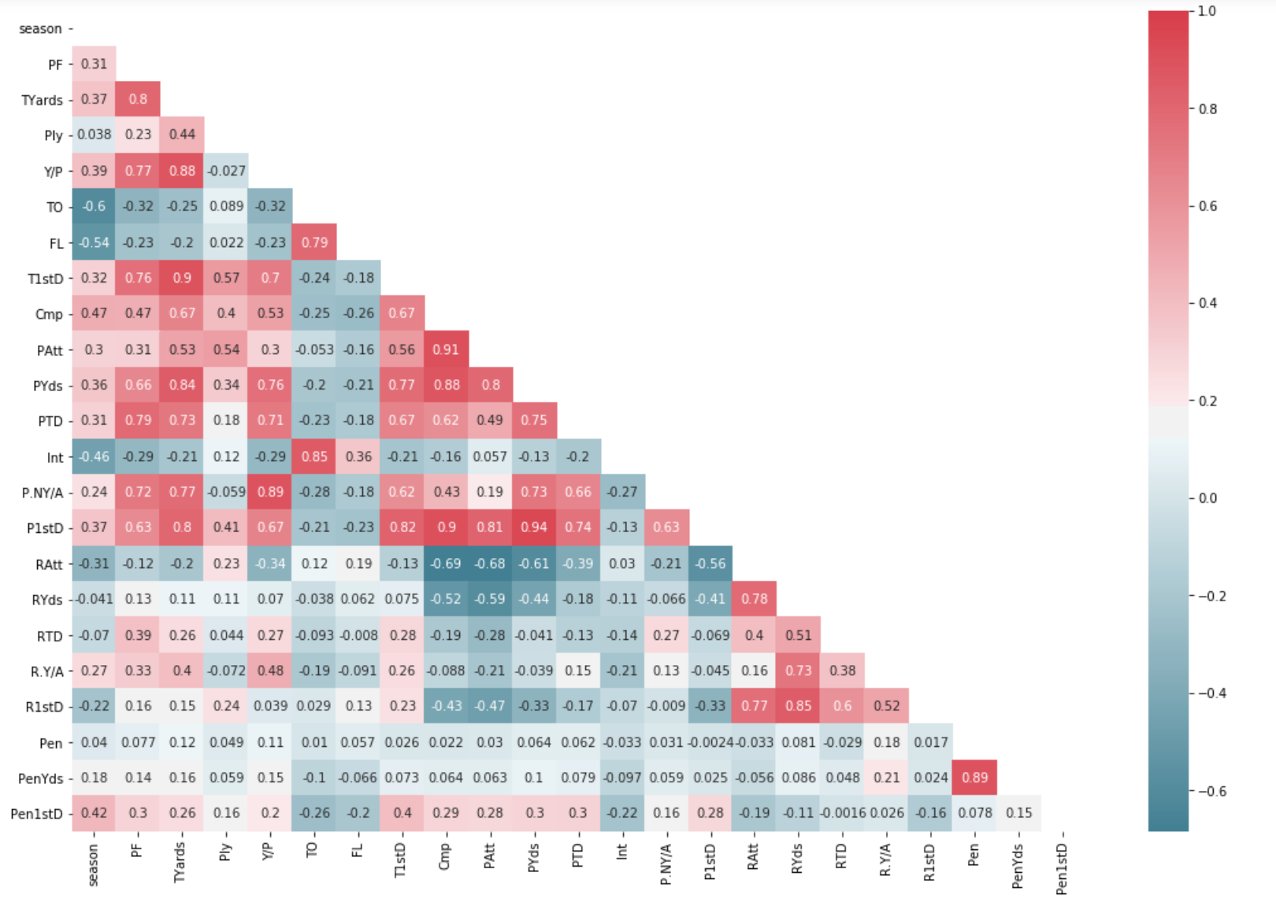
Offensive Correlation Matrix
Passing and Rushing measures are unsurprisingly correlated with one another, respectively.
Points For correlates more positively with passing metrics than rushing
Penalties are not closely correlated with offensive results nor the season
Turnovers are positively correlated with one another as well

Slide 5
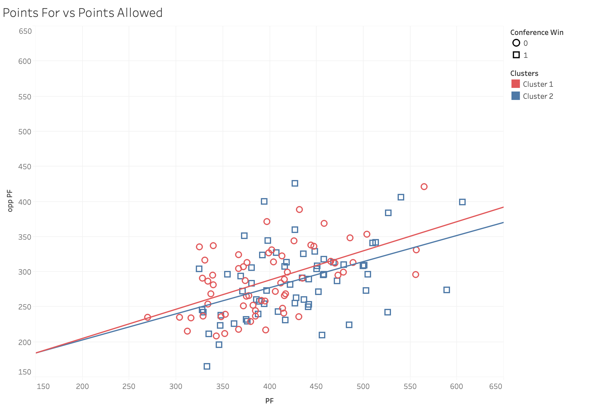
Points For & Points Allowed
We see a clear general trend that as a team’s Points For total increases, so does the Points Allowed, which makes sense with regards to Time of Possession
As the trend lines suggest, Super Bowl contenders are more often the teams which best mitigate their opponents additional chances to score.
Could also be a result of an easier schedule or conference strength

Slide 6
Predicting Conference Game Contenders
Focus on Conference game as it gives a relatively balanced ratio of the two classes as four teams out of twelve go to the Conference game each season
Considered four different classification models
Decision Tree
Random Forest
Support Vector Machines
Neural Nets
For Decision Trees and Random Forests, also tested with Principal Component Analysis to see what, if any, effect feature reduction would have on the results.

Slide 7
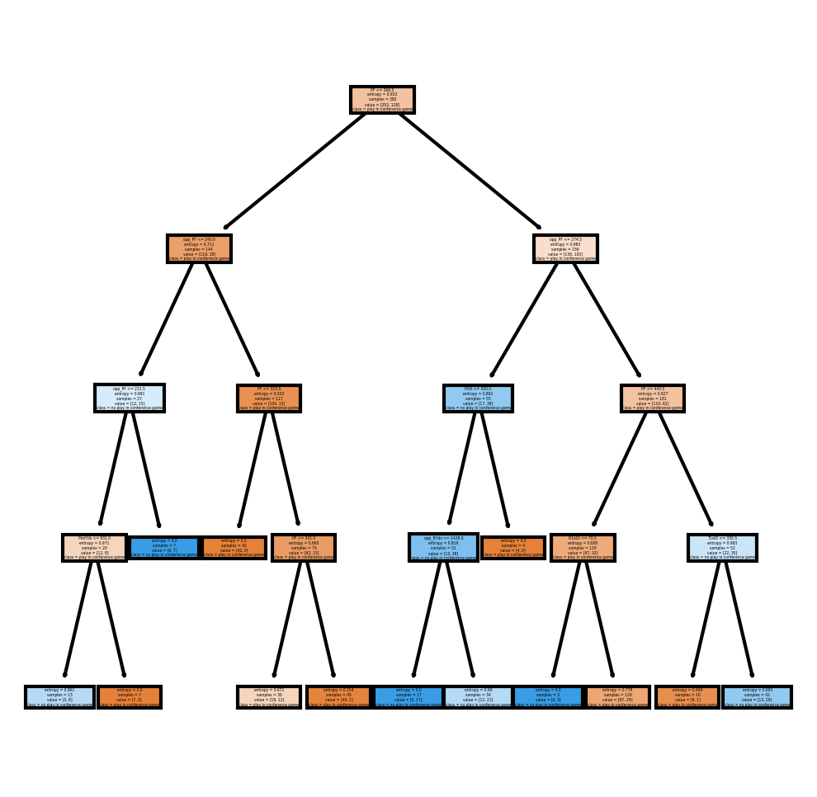
Decision Trees
Uses Information Gain, or the reduction of Entropy to determine which dataset features are the most powerful indicators for classification
Creates a hierarchical decision structure splitting instances into nodes based on the purity of the split each feature is able to create
In our case, shows that team’s offensive and defensive performances are roughly equal in importance with Points For and Points Allowed proving to be some of the most important factors

Slide 8
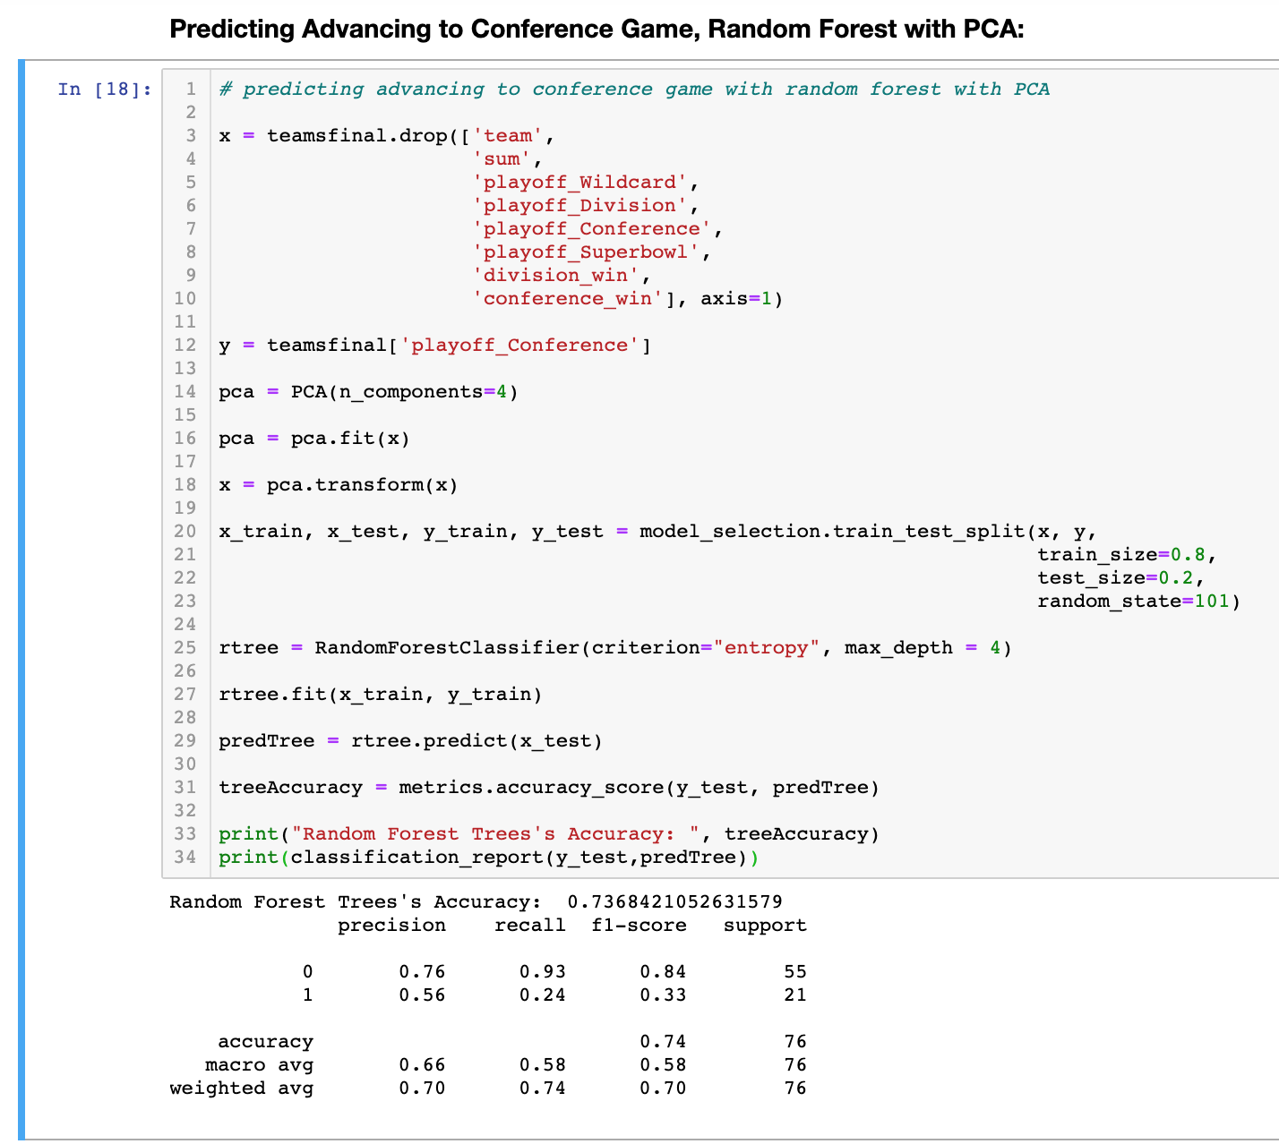
Random Forest
Creates numerous Decision Trees, each created using a random subset of dataset features
More robust in working with multi-collinearity given the random nature of the individual trees together
Sums up the number of votes for each instance and outputs this percentage of votes which can be assigned to a binary classification based on a cut-off value
In this case, use the default cut-off to evaluate the model’s default performance

Slide 9
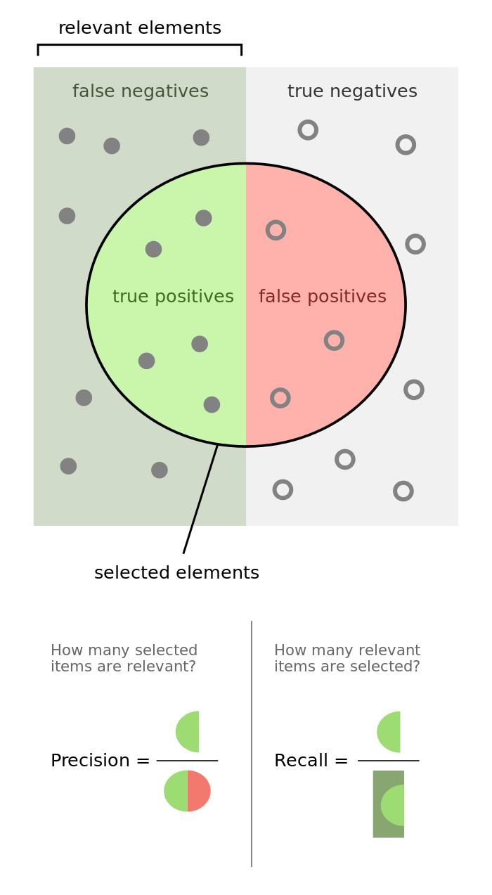
Precision and Recall
Precision: True Positives / True Positives + False Positives “How many of the Conference Championship participants we identified were actually participants?”
Recall: True positives / True positives + False Negatives “How many of all Conference Championship participants did we correctly identify?”
The F1 score is the harmonic mean of precision and recall: F1 = 2* (precisions*recall / precision + recall)
Which metric is the most important for this particular endeavor? We chose to focus on Precision to ensure our list of predicted winners included as many correct predictions as possible, even at the expense of not identifying other participants.

Slide 10
Classification for Conference Contenders
Generally, PCA improves results for predicting Conference contenders
Even with an optimized Random Forest model, precision is barely better than a coin toss
Decision Trees provide slightly better Recall, though the Random Forest performs better across the board
Results shown for classifying contenders, models perform much better predicting non-contenders, but this is to be expected due to the ratio
Model | Accuracy | Precision | Recall
Decision Tree | .70 | .43 | .29
Decision Tree, PCA | .68 | .42 | .38
Random Forest | .72 | .5 | .29
Random Forest, PCA | .74 | .56 | .24

Slide 11
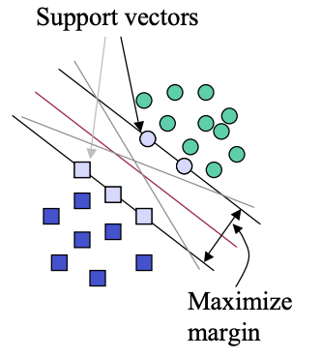
Support Vector Machines
Support Vector Machines maximize the margin around the separating hyperplane.
C: controls the trade off between smooth decision boundary and classifying training points correctly.
Kernel Linear: is a function that takes low dimensional input space and transforms it to a higher dimensional space.
Gamma: defines how far the influence of a single training example reaches.
B-value: The bias term which ensures the SVM is not forced to pass through the origin

Slide 12
Support Vector Machine Performance
With Default Kernel, Tuned Parameters: C = 10, gamma = .001, kernel = ‘rbf’ Accuracy: 0.6447368421052632
0 [[45 5] 1 [22 4]]
precision recall f1-score support
0 0.67 0.90 0.77 50
1 0.44 0.15 0.23 26
With Linear Kernel, Tuned Parameters: C=1, gamma='scale', kernel=’linear’ Accuracy: 0.6842105263157895
0 [[43 7] 1 [17 9]]
precision recall f1-score support
0 0.72 0.86 0.78 50
1 0.56 0.35 0.43 26
263/280 training instances used as support vectors B = .275

Slide 13
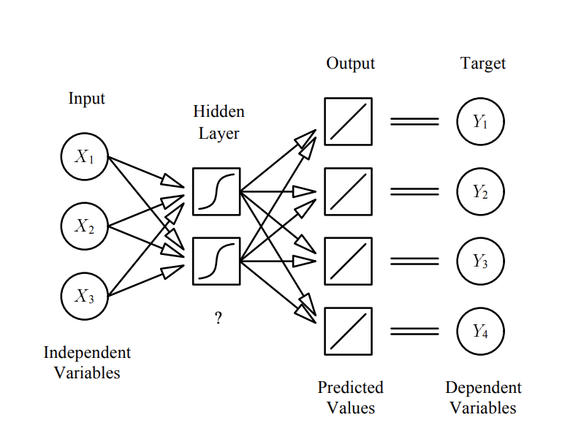
Neural Net Introduction
Neural Nets are a function from an input space to an output space, with a hidden layer that takes the function from multiple linear regression to a Neural Network.
Alpha value: Learning rate of the neural Net.
L-BFGS solvers: L-BFGS uses an estimation to the inverse Hessian matrix. L-BFGS stores only a few vectors that represent the approximation implicitly. This method is particularly well suited for optimization problems with a large number of variables, especially with relatively small datasets.

Slide 14
Neural Net Performance
Default Neural Net: Accuracy: 0.618421052631579
0 [[39 11] 1 [18 8]] precision recall f1-score support
0 0.68 0.78 0.73 50
1 0.42 0.31 0.36 26
- Did not converge after default 200 iterations.
1 Hidden Layer Neural Net with lbfgs Solver: Accuracy: 0.6973684210526315
0 [[46 4] 1 [19 7]] precision recall f1-score support
0 0.71 0.92 0.80 50
1 0.64 0.27 0.38 26
- Simplest architecture worked best - Logistic activation function provides more balanced results with a f1-score of .5 for 1 output

Slide 15
Predicting Conference Contenders
The tuned Neural Net ultimately provides the highest precision, ideal for our purpose.
Neither of the more complicated models outperform the random forest in terms of overall accuracy.
The Neural Net’s performance roughly reflects that of a typical industry analyst’s predictions
Model | Accuracy | Precision | Recall
Decision Tree | .68 | .42 | .38
Random Forest | .72 | .50 | .24
Support Vector Machine | .68 | .56 | .35
Neural Net | .69 | .64 | .27

Slide 16
Conclusions & Takeaways
Defining important parameters is key to evaluation
Tuning helps, but only to the extent the data is actually separable and predictable
The black-box nature of Neural Nets makes tuning difficult, but processing power alleviates some of the challenges
Complexity is not always superior, simplistic models can often generalize better than more sophisticated techniques
Understanding the unique parameters of each model is crucial to performance and troubleshooting

Slide 17
Future Improvements & Considerations
Normalizing data across years or decades to standardize seasonal data relative to the era of the game
Creating new metrics which bring in the league-wide averages for various stats to compare playoff teams to non playoff-bound teams
Re-incorporate betting data now that duplicate instances have been removed
Create a more thorough grid search for testing various architectures of a neural net’s hidden layers and other attributes

Slide 18
Thank you!
Questions?

